Slide 1
Study course "Civil Protection"
6. Safety tips
in the event of disasters
Developed in the framework of the European Commission’s Civil Protection Financial Instrument "Track1" project "Establishment of comprehensive civil protection and disaster management training for governmental institutions, civil protection commissions of municipalities, universities, Fire Safety and Civil Protection College, as well as establishing safety advice for the public" (ECHO/SUB/2022/TRACK1/884396)
Funded by The European Union
State Fire and Rescue Service

Slide 2
Tasks
Intended results
To introduce educatees to:
algorithms for dealing with disasters.
Educatees:
know the algorithms to follow in the event of a disaster,
understand the importance of individual preparedness and the actions to be taken to achieve it.

Slide 3
Table of contents
6.1. Natural disasters
6.2. Anthropogenic disasters
6.3. Individual preparedness

Slide 4
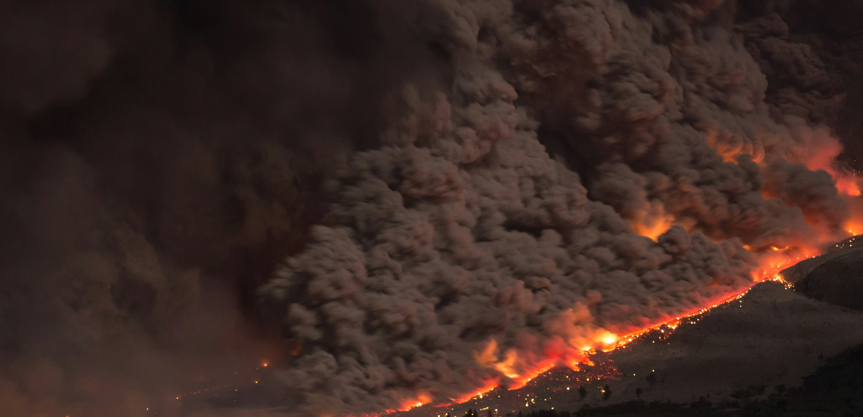
Introductory discussion with learners on emergency preparedness
Do you know what steps should be taken in the event of an emergency warning (e.g. floods, thunderstorms)?
Do you know how to prepare your home for emergencies?

Slide 5
Categorisation of disasters according to cause Natural disasters
Natural disasters
Geophysical
Hydrological
Meteorological
Climatological
Organic
Cosmic*
Earthquakes
Floods
Heavy rainfall, hail​
Intense cold, snow​
Epidemics
Landslides
Snow drifts
Icing
Epizootics
Storms, whirlwinds
Drought
Epiphytoties​
Fires in forests and peat bogs​
Civil Protection and Disaster Management Law​
Heat
*The National Civil Protection Plan does not include cosmic disasters

Slide 6
Categorisation of disasters according to cause Anthropogenic or man-made disasters
Anthropogenic or man-made disasters
Terrorist attacks​
Public disorder,
Internal conflict
Technogenic disasters
Release of substances​
Radiation
Fires in buildings and structures
Chemicals
Collapse of buildings and structures
Biological substances
Ships
Dams and other hydraulic structures
rupture of structures
Railway
Damage to electricity networks
Road transport
Utilities emergencies
Civil Protection and Disaster Management Law​
Aviation
Vehicle accidents

Slide 7
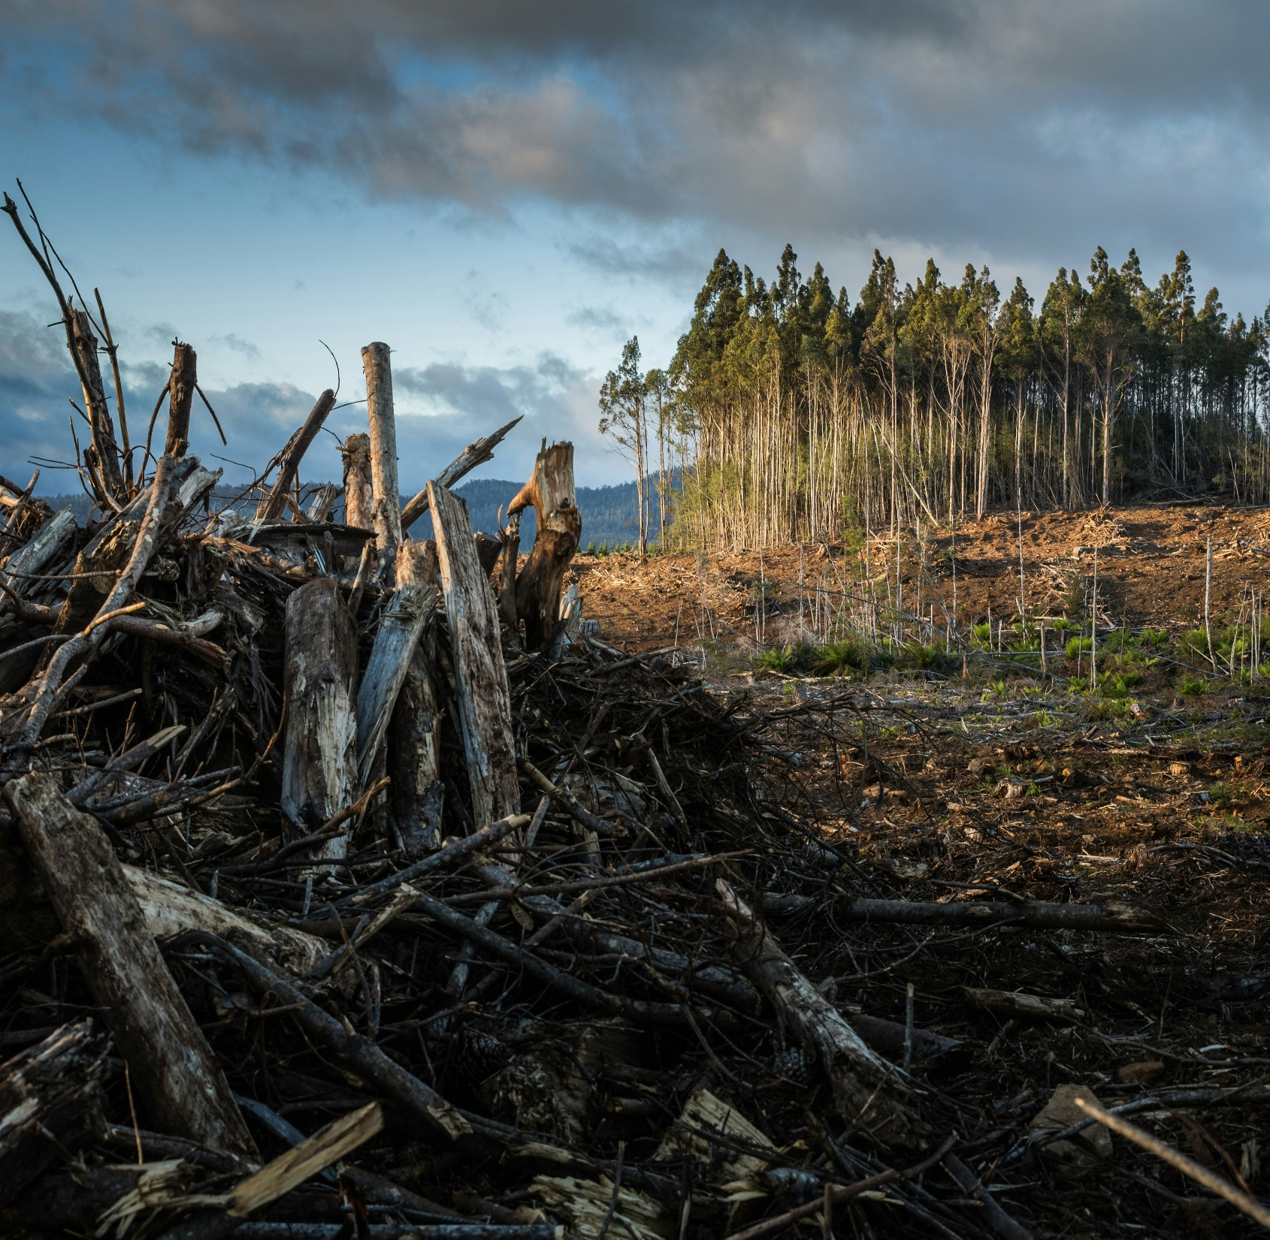
6.1. Natural disasters

Slide 8
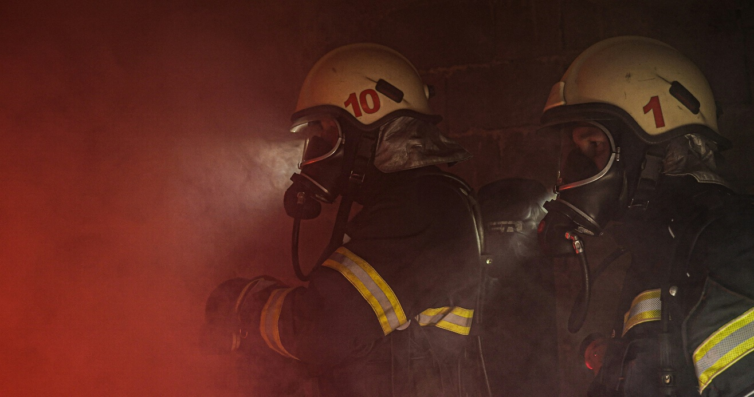
Fires in forests and peat bogs​ How to proceed?
6.1
Natural disasters
6.2
6.3
What should you do if you see a fire?
What should you do if you are caught in a forest fire?
Call 112 immediately and describe the location of the fire as accurately as possible.
If a forest fire starts as a result of a campfire, try to put it out immediately by hitting the flames with branches, a blanket or any other accessible object. Remember! The fire shall be extinguished by oblique blows in the direction of the burned area.
If the fire cannot be extinguished, warn others immediately and move away from the fire to a road, woodland, field or reservoir.
Move perpendicular to the direction of fire spread. If it is not possible to leave the fire, immerse yourself in water or cover yourself with wet clothes. If you're in a wooded area, lean closer to the ground.
Remember! The air near the ground is less smoky.
If you leave the scene of a fire, call 112 to report it.

Slide 9
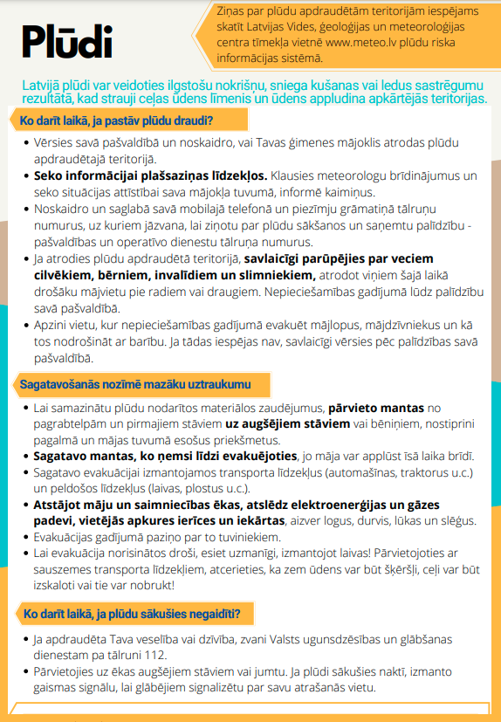
Floods and windstorms How to proceed?
6.1
Natural disasters
6.2
6.3
Check out the materials prepared by the State Fire and Rescue Service (SFRS):
Video "What to do in case of flooding?"
Summary of SFRS material on floods

Slide 10
Torrential rain, persistent rain and hail How to proceed?
6.1
Natural disasters
6.2
6.3
Torrential and persistent rain, large hail:
Listen to the warnings from meteorologists, keep an eye on the situation.
Follow the instructions and recommendations of the services, authorities and agencies.
Stay indoors if possible.
If you are outdoors, find somewhere to shelter (in a building).
Avoid driving mechanised and non-mechanised vehicles, or pull over in heavy rain, or seek shelter with transport in case of hail.

Slide 11
Thunderstorms and strong winds How to proceed? (1/4)
6.1
Natural disasters
6.2
6.3
What if a thunderstorm has started and you are in a building?
Stay in the building and keep others from going outside.
Avoid contact with electrical appliances, wires and metal objects.
Unplug electrical appliances.
Do not wash your hands, dishes or laundry. Don't shower. Do not heat the stove or oven.
Do not go near windows or doors, or stay on verandas, balconies or loggias.
If there is a fallen tree, downed wires, accident or other incident, call 1 1 2.
Notes:
https://www.vugd.gov.lv/lv/stiprs-vejs-negaiss

Slide 12
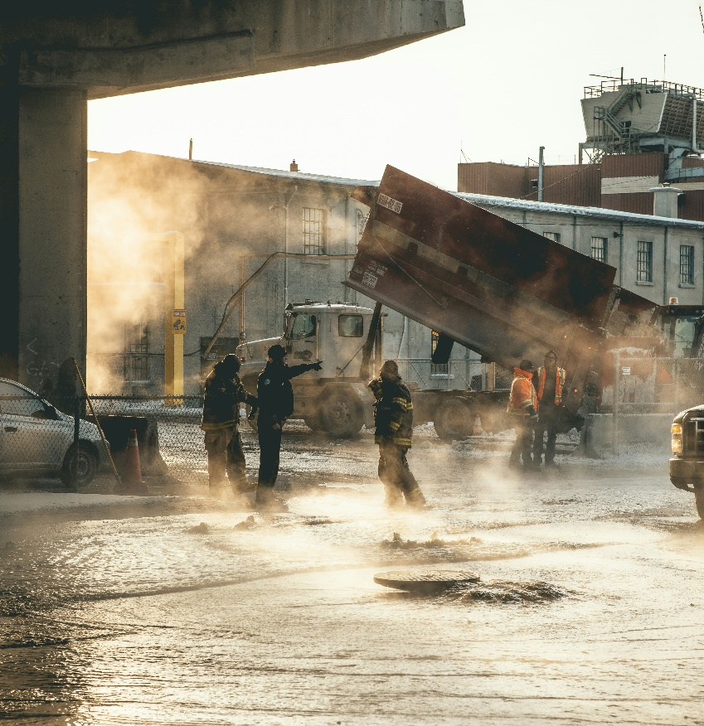
Thunderstorms and strong winds How to proceed? (2/4)
6.1
Natural disasters
6.2
6.3
What if a thunderstorm has started and you are outside the building?
Take shelter in a building or car. Remember! If you are in a car, find a safe place to stop. Stay in it, avoid touching metal surfaces and switch on the hazard warning light.
When in the forest, seek shelter in a lower area, in a thicket with low trees.
If you are in an open area, take shelter in a low spot, such as a ravine or valley. Avoid being on hills, in open fields, near power lines.
If you are on the water, try to get to shore and seek shelter immediately.
Avoid sheltering in sheds, small buildings or under large isolated trees in open areas.
Do not lie on concrete surfaces or lean against concrete walls.
Remove valuables, avoid contact with metal objects, farm machinery, bicycles and the like.

Slide 13
Thunderstorms and strong winds How to proceed? (3/4)
6.1
Natural disasters
6.2
6.3
How to prepare for thunderstorms and strong wind gusts when you receive a warning:
Do not leave the building without a particular need.
Be prepared for power cuts. Remember! Charge your mobile phone in time.
Secure objects on the balcony or in the courtyard that could be blown away and cause damage.
Close doors and windows, blinds and curtains.
Disconnect electrical equipment in advance. A surge of current or voltage caused by lightning can cause serious damage.
Do not park under trees, construction scaffolding, billboards, power lines.

Slide 14
Thunderstorms and strong winds How to proceed? (4/4)
6.1
Natural disasters
6.2
6.3
Electrical safety during storms - if a wind-broken tree has fallen on your house and is interfering with the electricity supply, do not approach the damaged or broken power lines of the broken tree, but immediately contact "Sadales tīkls" Customer Service on the free phone number 8404 and inform about the situation.
What to do if the power goes out:
If your building suddenly loses electricity, check whether the power is out only in your home, in the whole building or in nearby neighbouring buildings. At dusk and in the dark, you can look out of the window and see if the windows of the neighbouring buildings are lit.
If you find that there is no electricity in the whole house or in the wider area, call the free fault reporting line of "Sadales tīkls" at 80 200 404.
Switch off or disconnect power-consuming devices so that they can be safely operated when the power supply is restored.
Only use your mobile phone in emergencies and only call 1 1 2 in situations where life or health is at risk. In the event of prolonged power cuts, you will need a mobile phone to contact and get help.
To protect your electrical installations from the effects of short-term voltage interruptions, you can use uninterruptible power supplies - UPS - to keep various electrical appliances running during power cuts.

Slide 15
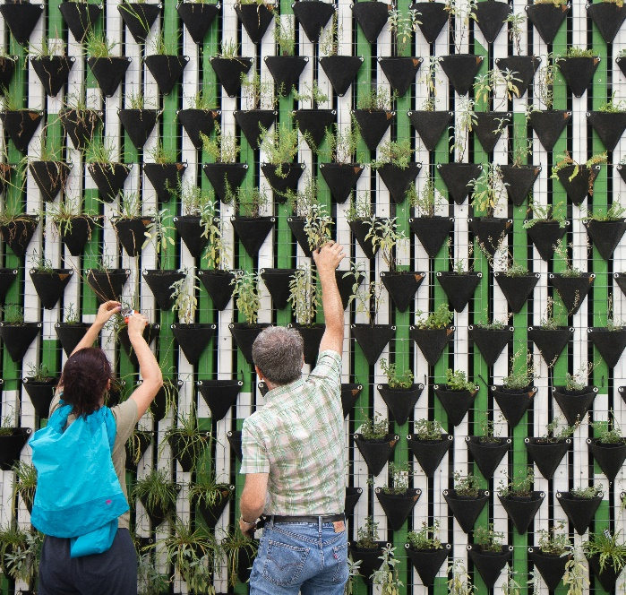
Severe cold, heat, drought How to proceed?
6.1
Natural disasters
6.2
6.3
Severe cold:
Heat:
Severe drought:
Listen to the warnings from meteorologists, keep an eye on the situation.
Do not build fires or throw smoke in forests, meadows or other places where fires can start.
Follow the instructions and recommendations of the services, authorities and agencies.
Stay at home or indoors.
Try to be in ventilated/cooled living and working areas. Natural ventilation (opening windows) is best done in the evening, at night. During the day, close and cover windows to reduce indoor heating.
When going outdoors, dress appropriately for the weather (warm and comfortable clothes and shoes).
Wear light, light, breathable clothes when going out. Use a light-coloured, thin-fabric headgear to prevent your head from getting hot.
When moving around, consider your route to minimise the number of trees, power lines and other things that could break or fall from freezing.
Take more fluids than usual. Do not drink alcohol, strong coffee or tea, as these drinks increase the dehydration of the body.

Slide 16
Snow and blizzards, ice and wet snow How to proceed?
6.1
Natural disasters
6.2
6.3
Heavy snow and blizzard:
Heavy icing:
Listen to the warnings from meteorologists, keep an eye on the situation.
Stay indoors if possible.
Follow the instructions and recommendations of the services, authorities and agencies.
If you are outdoors, move slowly and sensibly.
If you are outdoors, find somewhere to shelter (in a building).
When moving around, consider your route to minimise the number of trees, power lines and other things that could break or fall from freezing.
Avoid driving mechanised and non-mechanised vehicles or pull over in heavy snow or blizzards.
Avoid driving mechanised and non-mechanised vehicles, choose an appropriate speed or pull over in case of heavy icing.

Slide 17
Earthquakes How to proceed?
6.1
Natural disasters
6.2
6.3
If you are indoors, stay there. Move quickly to a safer place in the room, such as under a massive table, against an interior wall or in a doorway. The purpose of this movement is to protect yourself from falling objects. Avoid corners near windows, large mirrors, hanging objects, heavy furniture, fireplaces and stoves.
Under no circumstances should you try to escape from a building during an earthquake, as falling parts of the building in the stairwell or collapsing stairs could injure or kill you. Only at the very beginning of the earthquake should those who are close to the outer exit door get out of the building as quickly as possible and take shelter in as much cover as possible.
If you are cooking, turn off the cooker and move to a safer place in the room.
If you are in a crowded area, avoid panicking and do not rush for the exit. Kneel down and cover your head and neck with your arms and hands.
If you are outside, move to an open area where falling objects are unlikely to hit you. Move away from buildings, power lines and trees.
If you are in a car, slow down slowly and stop on the side of the street. Avoid stopping on and under bridges and overpasses, power lines, trees and large signs. Stay in the car!

Slide 18
6.2. Anthropogenic disasters

Slide 19
Fires How to proceed?
6.1
6.2
Anthropogenic disasters
6.3
If you can get out of the room:
If you are safe outside or inside a building, call 112.
If the door is not hot when you feel it, open it a little and make sure there is no smoke or fire outside.
If there is a little smoke in the room, crawl to the window, slowly open it and shout "Help!" and use other ways to draw attention to yourself. Remember! Opening the window completely will create a draft that will contribute to the smoke entering the room. Keep in mind that only in cases of extreme necessity should you open the window completely or break the glass. Smoke can also enter the room from outside the house by opening a window completely or breaking the glass. In addition, if the glass is broken, you will no longer be able to close the window.
Close the door when you leave the room. This will reduce the spread of fire and protect property.
Keep low to the window, this will allow you to breathe fresh air from outside and avoid the smoke that will slowly fill the room.
If you can't get out of the room:
If the door feels hot when you feel it, do not open it. This can mean that there is a fire outside the door. Remember! If you open the door, flames will immediately enter the room.
If possible, cover your nose and mouth with a moistened material. This will filter the smoke and make it easier to breathe.
If the door is hot, plug the door gaps. Remember! Wet towels and blankets are best for this. Sheets, clothes are also useful.
If you are on the ground floor of a building and can get out safely through a window, do so.

Slide 20
Road traffic accident How to proceed?
If you see a car accident:
Stop your car at a safe distance from the accident.
Switch on your car's hazard lights.
Take a first aid kit, emergency sign.
Place the emergency sign at the required distance from the accident scene.
Go to the scene of the accident.
If the victim needs help:
If the victim's life is in danger or unconscious
Call an ambulance on 113.
Gently pull the victim out of the car.
Leave the victim in the car.
Take resuscitation measures if necessary.
Do not move the victim yourself! Do not let others move the victim!
Give the help you need.
Care for, reassure the victim.

Slide 21
Collapse of structures How to proceed?
6.1
6.2
Anthropogenic disasters
6.3
If you are trapped in a collapse:
If the building has started to collapse:
If you have a mobile phone, call 112.
Situations vary, as do building designs, so take the following advice into account when assessing the risks:
Cover your mouth with a cloth or clothing when you breathe.
Try to take shelter under a strong protective barrier, e.g. in a doorway of a load-bearing inner wall, under a table. Do not approach or seek shelter near windows or external walls.
Use any means to attract the attention of rescuers, such as knocking on building structures, pipes, radiators.
Kneel down, cover your head and neck with your arms. This posture will prevent you from falling and partially protect vital organs.
If there is a risk of building collapse
Stay put until the collapse ends.
Leave the building immediately.
When the collapse ends, leave the building, avoiding unstable objects or structures. Remember! Do not use the lift when leaving the building!
Do not use the lift.

Slide 22
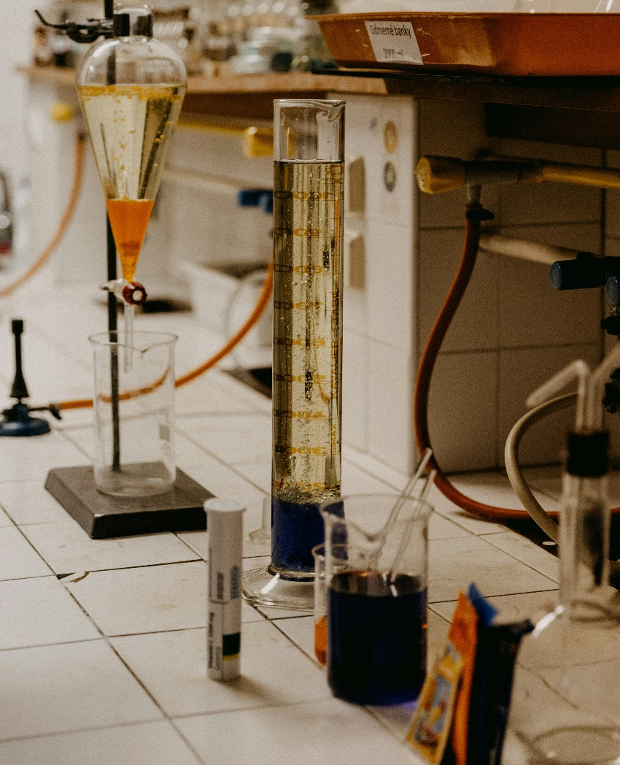
On-site release of hazardous chemicals How to proceed? (1/2)
6.1
6.2
Anthropogenic disasters
6.3
What if there is a spill of hazardous chemicals or a radiation accident and you are outside?
When at or near the epicentre of the event, stand perpendicular to the 90° wind direction (with the wind blowing from the side) and walk at least 800 metres forward out of the danger area.
Inform others about what happened.
Do not touch liquid or solid chemicals, or enter clouds of smoke or mist. Cover your mouth with a cloth or clothing when leaving the contaminated area.
If you have been exposed to dangerous substances and feel unwell, seek medical help.
Do not return to the premises without the permission of the emergency services. Open the windows to ventilate the rooms.

Slide 23
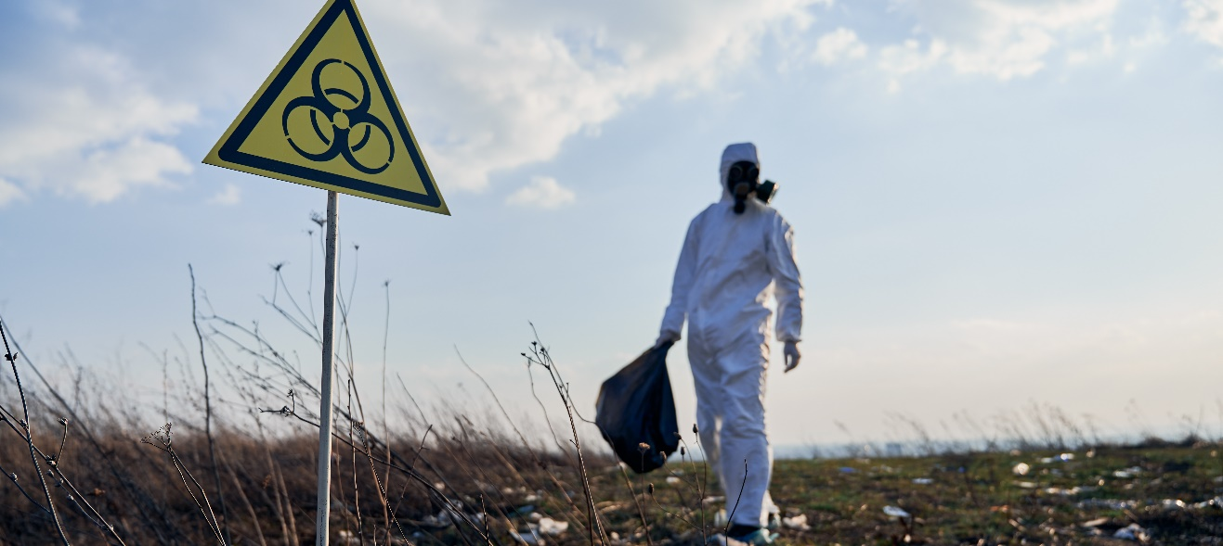
On-site release of hazardous chemicals How to proceed? (2/2)
6.1
6.2
Anthropogenic disasters
6.3
What if there is a release of hazardous chemicals or a radiation accident and you are in a building?
What if there is a spill of hazardous chemicals or a radiation accident while driving?
Stay in the building.
Stop and seek shelter in a building.
Close external doors, internal doors, windows and all possible openings to prevent outside air from entering.
If you have to stay in the car, keep the windows closed and turn off the ventilation, air conditioning and heater.
Close or turn off ventilation, air conditioners, seal openings for extractor fans in kitchens, bathrooms and other rooms with adhesive tape, cling film or aluminium foil.
Seal the openings under the door with damp towels or plastic sheeting and adhesive tape.
Go to the room that is above ground level and has the fewest openings to the outside.
If gases or vapours enter the building, take shallow breaths through a towel or other cloth.

Slide 24
Radiation accidents How to proceed? (1/4)
6.1
6.2
Anthropogenic disasters
6.3
What should be done in the event of a release of radioactive substances outside Latvia?
Residents are advised to stay indoors
Restrictions on food use and farming are recommended
Close windows and doors, turn off the ventilation system, seal gaps.
Do not use products from open fields and forests and water from open water bodies (surface water bodies) and uncovered wells.
Keep up to date with information from the relevant authorities on potential risks and protective measures.
Use packaged food and water that is stored indoors.
Personal hygiene - avoid hand to face contact, wash hands when entering rooms.
It is advisable to change shoes and clothing when entering indoor areas. Place the worn clothes in a polythene bag and keep out of the reach of people. The clothes can then be washed and reused.
If possible, use animal feed that is stored in closed or semi-closed spaces or packaged. Do not use water from open water bodies or uncovered wells to feed animals.

Slide 25
Radiation accidents How to proceed? (2/4)
6.1
6.2
Anthropogenic disasters
6.3
What should be done in the event of a release of radioactive substances outside Latvia?
If you are outdoors:
Use cloth, medical or FFP2 masks if possible.
It is advisable to change your shoes and clothes when entering indoor areas. Place the worn clothes in a polythene bag and keep out of the reach of people. The clothes can then be washed and reused.
Personal hygiene - avoid hand-to-face contact, wash hands when entering rooms.
If there has been precipitation during your stay outside, it is advisable to take a shower when you return indoors.
If you are working outside, do not drink, eat or smoke while you are working.
During rainfall, it is advisable to stay outdoors for as short a time as possible. Priority should be given to staying indoors.
Radioactive contamination is most dangerous in the first few hours. Stay indoors if possible!

Slide 26
Radiation accidents How to proceed? (3/4)
6.1
6.2
Anthropogenic disasters
6.3
What if there is a spill in Latvia?
If you are outdoors:
Go inside the nearest building.
If possible, take off your clothes, put them in a polythene bag and seal it.
If you do have to stay out, don't drink, eat or smoke.
If it is not possible to provide a change of clothes or to provide washing facilities, e.g. if it is not possible to return to your place of residence, then remove the outer layer of clothing and place it in an area where people are not present.
Remember hygiene! Avoid contact with the face. Wash your hands when entering rooms.
If possible, shower thoroughly with plenty of lukewarm water. Use detergents if possible. Try not to injure your skin.
Close windows and doors.
Turn off or shut down the ventilation system and air conditioners.
If possible, scrub vigorously, wash your hair and rinse it thoroughly. Remember! Do not use conditioner.
Seal openings for extractor fans in kitchens, bathrooms and other rooms with adhesive tape, cling film or aluminium foil.
Rinse your mouth with clean water.
Keep up to date with information from the relevant authorities on potential risks and protective measures.
Repeat the washing process two to three times. Avoid getting detergent foam in your eyes and mouth.

Slide 27
Radiation accidents How to proceed? (4/4)
6.1
6.2
Anthropogenic disasters
6.3
What if there is a spill in Latvia?
If you are in a building:
If you are in a car:
Do not leave the building.
Stop and seek shelter in a building.
Close external doors, internal doors, windows and all possible openings to prevent outside air from entering.
If you have to stay in the car, keep the windows closed and turn off the ventilation, air conditioning and heater.
Close or turn off ventilation, air conditioners, seal openings for extractor fans in kitchens, bathrooms and other rooms with adhesive tape, cling film or aluminium foil.
Radioactive contamination is most dangerous in the first few hours. Stay indoors if possible!
In rural areas, livestock must be brought indoors and feed and water sources must be sealed. Livestock must not be fed on feed stored in the open.
Keep up to date with information from the relevant authorities on potential risks and protective measures.
Keep a supply of drinking water in closed containers. Use food and water in packets or stored indoors.
Prepare respiratory protective equipment - face coverings, respirators, gas masks, clothing made of dense fabrics, gowns, gloves, boots.

Slide 28
6.3. Individual resilience

Slide 29
Items and supplies needed in the event of a temporary evacuation
6.1
6.2
6.3
Individual resilience
In case of emergency and temporary evacuation, you should take with you:
Proof of identity (passport, ID card)
Mobile phone and charger
Cash
Portable radio with batteries
Bank cards
Medicines if you need to take them regularly
Evacuation and emergency bag

Slide 30
Items and supplies needed in the event of a prolonged evacuation
6.1
6.2
6.3
Individual resilience
These are things that a person or family will need in the event of a prolonged and foreseeable evacuation, as well as in the event of an interruption to utilities - gas, electricity, water.
Things to take with you for a prolonged evacuation:
Copies of important documents in polythene wrapping
Clothing, spare underwear
Small amount of cash
Comfortable shoes
Portable radio, matches or lighter, torch, batteries
Sleeping bag or blanket, camping mat, preferably tent
Multifunctional folding knife, spoon, a leak-proof bowl and cup
Hygiene items, towels, toilet paper, disposable wipes
Tape, string, thread, needle, scissors, paper and stationery
Food which may be consumed without cooking and with a long shelf life
First aid kit
Drinking water
Evacuation and emergency bag

Slide 31
Home emergency kit
6.1
6.2
6.3
Individual resilience
The emergency services and the municipality will first assist socially vulnerable groups and people whose lives and health are at risk.
Everyone needs to prepare a home emergency kit to be able to live without outside help for 72 hours in case of an emergency.
Recommended reserves:
Drinking water and water for other uses (e.g.,
for washing)
Fire extinguisher
Products with a long shelf life
Warm blankets, sleeping bags, warm underwear (during the cold season)
First aid kit
Critical kit in case of evacuation or movement to shelter
Pocket torches, spare batteries or accumulators for them, candles
Alternative stand-alone heat source when the central heating system is not working
Gasburner with spare gas cylinders for cooking or other fuel stove
Hygiene and sanitary products
"What to do in case of war"

Slide 32
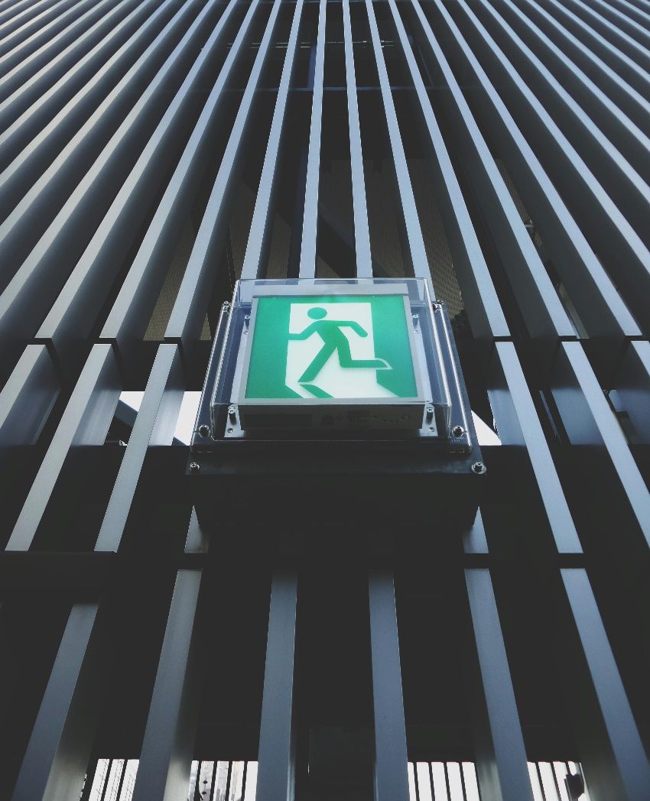
Evacuation
6.1
6.2
6.3
Individual resilience
What to do if you need to evacuate?
Listen carefully to the evacuation announcement, memorise and follow the evacuation direction, destination and assembly point.
If possible, use your own vehicle and drive in the direction indicated to your final destination or to a pre-selected shelter location that coincides with the evacuation direction.
If you cannot use your own vehicle, go to the nearest designated evacuation assembly point.
In case of evacuation, notify your family.
Remember! If possible, turn off the gas and electricity supply to your home before evacuating.

Slide 33
Establishment of shelters and their requirements
6.1
6.2
6.3
Individual resilience
Shelters are intended to be used in the event of war or military emergency to provide shelter for the population and to reduce the impact of blast, debris, thermal radiation or radiation contamination.
Individuals can set up 2 types of shelters:
A shelter in the basement or underground floor of your property that is for the exclusive use of the occupants of that building (in accordance with the guidelines of the SFRS).
A shelter in the basement or underground floor of your property, which will be accessible to any person in the vicinity (to be agreed with the Municipality). A sign is put up indicating that a shelter has been installed in the building.
For more information on minimum technical requirements and additional recommendations, see Guidelines on minimum technical requirements for potential shelters

Slide 34
Establishment of shelters and their requirements
6.1
6.2
6.3
Individual resilience
The adaptation of basement or other underground space for shelter
The best choice is a basement with a reinforced concrete slab and masonry walls.
Shelves made of durable material should be created along the walls, which can provide additional support to the wall, shelving and bed space.
Analternative exit from the shelter must be provided or created.
A ventilation system must be set up.
An independent heating system (stove), smoke/gas extraction system, fire safety should be considered.
If the cellar has windows, bags filled with sand or other loose materials or concrete blocks etc. should be prepared to cover them .
A portable cooker for food preparation must be provided.
Drinking water (in containers or bottles) should be provided at a rate of 3 litres per person, along with some food and warm clothes.
Toilet facilities must be provided.
Where possible, space for food supplies, human accommodation and sanitation should be separated.
If there are young children in the family, prepare a board game or other means to keep them occupied.
One or more responsible persons should be designated to care for and maintain the accessibility and orderliness of the premises.
"What to do in case of war"

Slide 35
Sources of information (1/2)
Images sourced from the website "Unsplash". https://unsplash.com
112. 2023. Biežāk uzdotie jautājumi par iedzīvotāju apziņošanu, rīcību militāra apdraudējuma gadījumā. https://112.lv/lv/raksts/210
112. Ceļu satiksmes negadījums. https://112.lv/lv/riciba-apdraudejuma-situacija/kategorijas/23/celu-satiksmes-negadijums
112. Elektrotīklu bojājumi. https://112.lv/lv/raksts/67/elektrotiklu-bojajumi?objects_path=lv%2Fraksts%2F67%2Felektrotiklu-bojajumi
112. Evakuācija. https://112.lv/lv/raksts/192/evakuacija
112. Evakuācija un ārkārtas gadījumu soma. https://112.lv/lv/raksts/225/evakuacija-un-arkartas-gadijumu-soma?objects_path=lv%2Fraksts%2F225%2Fevakuacija-un-arkartas-gadijumu-soma
Aizsardzības ministrija. 2024. Rokasgrāmata “Kā rīkoties kara gadījumā”. https://static.lsm.lv/documents/1ym.pdf
Civilās aizsardzības un katastrofas pārvaldīšanas likums. https://likumi.lv/ta/id/282333
Jēkabpils County Municipality. Dokumentālā filma "Plūdi" (Jēkabpils, 2023. gads). https://www.youtube.com/watch?v=ZJBtqAgrEZE
LTV Ziņu dienests. 72. stundas. Evakuācija un pretošanās. https://www.youtube.com/watch?v=EqTN-akzLIc
LTV Ziņu dienests. Ogrē spridzina ledu. https://www.youtube.com/watch?v=7fol0QqgihA
Ministru kabineta 2002. gada 20. augusta noteikumi Nr. 372 "Darba aizsardzības prasības, lietojot individuālos aizsardzības līdzekļus". https://likumi.lv/ta/id/65619
Ministru kabineta 2002. gada 21. maija noteikumi Nr. 189 "Darba aizsardzības prasības, saskaroties ar bioloģiskajām vielām". https://likumi.lv/ta/id/62417
Ministru kabineta 2003. gada 26. jūnija rīkojums Nr. 414 "Par Radioaktīvo atkritumu glabāšanas koncepciju". https://likumi.lv/ta/id/76761
Ministru kabineta 2003. gada 8. aprīļa noteikumi Nr. 152 "Prasības attiecībā uz sagatavotību radiācijas avārijai un rīcību šādas avārijas gadījumā". https://likumi.lv/ta/id/73845
Ministru kabineta 2004. gada 30. novembra rīkojums Nr. 958 "Par Salaspils kodolreaktora likvidēšanas un demontāžas koncepciju". https://likumi.lv/ta/id/97446
Ministru kabineta 2013. gada 8. oktobra noteikumi Nr. 1041 "Noteikumi par obligāti piemērojamo energostandartu, kas nosaka elektroapgādes objektu ekspluatācijas organizatoriskās un tehniskās drošības prasības". https://likumi.lv/ta/id/260769
Ministru kabineta 2014. gada 18. marta noteikumi Nr. 143 "Darba aizsardzības prasības, strādājot augstumā". https://likumi.lv/ta/id/265121
Ministru kabineta 2015. gada 22. decembra noteikumi Nr. 746 "Noteikumi par kuģu, kuģošanas kompāniju, ostu un ostas iekārtu aizsardzības funkciju sadalījumu, izpildi un uzraudzību". https://likumi.lv/ta/id/278913

Slide 36
Sources of information (2/2)
Ministru kabineta 2016. gada 1. marta noteikumi Nr. 131 "Rūpniecisko avāriju riska novērtēšanas kārtība un riska samazināšanas pasākumi". https://likumi.lv/ta/id/280652
Ministru kabineta 2016. gada 19. aprīļa noteikumi Nr. 238 "Ugunsdrošības noteikumi". https://likumi.lv/ta/id/281646
Ministru kabineta 2017. gada 7. novembra noteikumi Nr. 658 "Noteikumi par civilās aizsardzības plānu struktūru un tajos iekļaujamo informāciju". https://likumi.lv/ta/id/294938
Ministru kabineta 2019. gada 18. jūnija noteikumi Nr. 268 "Valsts materiālo rezervju izmantošanas un pārbaudes kārtība". https://likumi.lv/ta/id/307788
Ministru kabineta 2020. gada 26. augusta rīkojums Nr. 476 "Par Valsts civilās aizsardzības plānu". https://likumi.lv/ta/id/317006
Ministru kabineta 2021. gada 1. aprīļa noteikumi Nr. 199 "Valsts uzraudzībā esošās dzīvnieku infekcijas slimības vai epizootijas uzliesmojuma laikā radušos zaudējumu kompensācijas noteikumi". https://likumi.lv/ta/id/322169
Ministru kabineta 2022. gada 12. aprīļa noteikumi Nr. 230 "Valsts augu aizsardzības dienesta nolikums". https://likumi.lv/ta/id/331660
Neatliekamās medicīniskās palīdzības dienests. 2023. Rīcība ceļu satiksmes negadījumos. https://www.nmpd.gov.lv/lv/riciba-celu-satiksmes-negadijumos
Neatliekamās medicīniskās palīdzības dienests. 2024. Ārkārtas situācijas. https://www.nmpd.gov.lv/lv/arkartas-situacijas
Rīgas dome. 2024. Patvertnes vai vietas, kur patverties. https://www.riga.lv/lv/situacija-patvertnu-jautajuma
Sargs.lv. 2022. Nacionālie bruņotie spēki ir gatavībā sniegt atbalstu plūdu seku likvidēšanā. https://www.sargs.lv/lv/nbs/2022-01-06/nacionalie-brunotie-speki-ir-gataviba-sniegt-atbalstu-pludu-seku-likvidesana
Valsts ugunsdzēsības un glābšanas dienests. 2021. Plūdi. https://www.vugd.gov.lv/lv/pludi
Valsts ugunsdzēsības un glābšanas dienests. 2021. Stiprs vējš, negaiss. https://www.vugd.gov.lv/lv/stiprs-vejs-negaiss
Valsts ugunsdzēsības un glābšanas dienests. 2024. Vadlīnijas potenciālo patvertņu minimālajām tehniskajām prasībām. https://www.vugd.gov.lv/lv/vadlinijas-potencialo-patvertnu-minimalajam-tehniskajam-prasibam
Valsts ugunsdzēsības un glābšanas dienests. Katastrofu riska novērtēšanas rekomendācijas. https://www.vugd.gov.lv/lv/media/340/download
VUGD. Kā rīkoties plūdu gadījumā? https://www.youtube.com/watch?v=TqCewTZAWdU&t=57s

